Slide 1

Introduction To Unit Testing
Pravinkumar R .D.

Slide 2
What is Unit Testing?
A way of testing unit –
Logically isolated part of application
Written by developers
Runs automatically when there is change in code
Designed to target and validate smallest part of code –
Functions or methods
Checking different assertions/outcomes of the unit
First level of testing in Software Development Lifecycle [SDLC]

Slide 3
Different Types of Tests
Manual Testing –
Tests which are performed by humans
Without any scripts
Error prone
Automated Testing –
Tests which are performed by testing tools and written as scripts
Less Error prone
Q.A. makes usage of testing framework while writing test cases

Slide 4
Disadvantages of Manual Testing
Not accurate as written by humans
Time consuming process
Require human resource
Good where the test cases are run once or twice
They are slower
Think about an example of –
Manual Lathe Machine VS CNC machines/ Lathe Machine

Slide 5
Advantages of Automated Testing
Performed by tools and/or scripts
They are less error prone and reliable as they are run by tools
Faster than manual testing
Good where the test cases run repetitively
Whenever the are changes in code
No human resource/observations are required
Investment in tools instead of humans

Slide 6
“AAA” of Testing
Arrange –
Act –
Assert –
Arranging The Test
Acting
Asserting

Slide 7
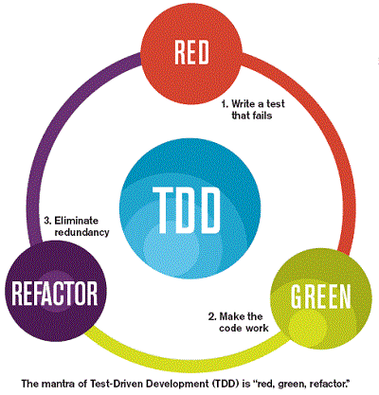
What is Test Driven Development?

Slide 8
Angular and Unit Testing
Angular Testing Tools –
Jasmine – Testing Framework
Karma – Test Runner
TestBed – Angular’s testing environment

Slide 9
Jasmine Testing Framework
Jasmine is a behavior-driven development framework for testing JavaScript code
Uses natural language, making tests more readable and understandable
Doesn’t require external dependencies or DOM
Easy to setup and use
Jasmine uses a descriptive syntax with keywords like –
Describe component test what It should do and the Expectation
For Example – Component Test – It should have Title - Welcome

Slide 10
Jasmine Testing Framework
Jasmine provides a rich set of matchers to perform assertions –
toBe, toEqual, toMatch, toBeDefined, toBeUndefined, toBeNull Etc.
Jasmine includes built-in support for spies
Spies are used for tracking function calls and their arguments
Setup and Teardown –
Framework provides beforeEach() and afterEach() functions to setup and teardown test environment before and after each test case
Jasmine supports asynchronous testing

Slide 11
Karma – The Test Runner
Karma is a test runner developed by the AngularJS team
Karma offers –
Running test cases in real browser
It supports various frameworks like –
Jasmine, Mocha, QUnit etc.
Easy integration with CI tools like Jenkins and others
Supports all browsers like desktop, mobile and tablets
Developed and maintain by open-source community

Slide 12
What is TestBed?
The primary API for writing unit tests in Angular
It allows you to configure and create an Angular testing module
Provides a way to initialize and interact with Angular components and services in a controlled testing environment

Slide 13
Why do we need TestBed?
Isolation –
Ensures that tests are isolated and can run independently of the rest of the application
Configuration –
Allows you to configure the testing environment, including providing mock dependencies, setting up necessary modules, and declaring components
Makes it easy to create a consistent and reproducible test setup

Slide 14
Why do we need TestBed?
Component Interaction –
Enables you to create instances of Angular components and access their properties and methods
Makes it easier to test component logic and interactions
Dependency Injection [D.I.] –
Supports Angular's dependency injection system
Allows you to inject Services and other dependencies for tests
Lifecycle Hooks –
Allows you to test Angular lifecycle hooks

Slide 15
Writing Unit Test
Basic structure of Test –
Describe –
Group related test cases
For example – Testing parts of components
It –
Writing individual test cases in a group
Expect –
Assertion to check the output
Expectation checking

Slide 16
Example
describe('AppComponent', () => {
it('should create the app', () => {
const fixture = TestBed.createComponent(AppComponent);
const app = fixture.componentInstance;
expect(app).toBeTruthy();
});
});

Slide 17
Explanation
describe() function –
Defines a test suite for the AppComponent
it() function –
Function defines a single test case within the suite, which is checking if the app is created
TestBed.createComponent(AppComponent) –
Creates an instance of AppComponent in test environment
Adds a corresponding element to the test-runner DOM
Returns Component Fixture

Slide 18
Explanation
Component Fixture –
Is a test harness for interacting with the created component and its corresponding element
const app = fixture.componentInstance –
Gets the instance of the component
expect(app).toBeTruthy() –
Asserts that the component instance is truthy, meaning it exists and was created successfully
Let’s look at few components test cases

Slide 19
Introduction to spyOn()
A Jasmine function used to create spies on existing objects
Helps in mocking and tracking function calls in unit tests
Mocking –
Replace the original function with a spy
Tracking –
Monitor function calls, arguments, and call count
Helps to –
Tests functions in isolation without side effects
Ensures functions are called as expected
Handles various scenarios by controlling return values

Slide 20
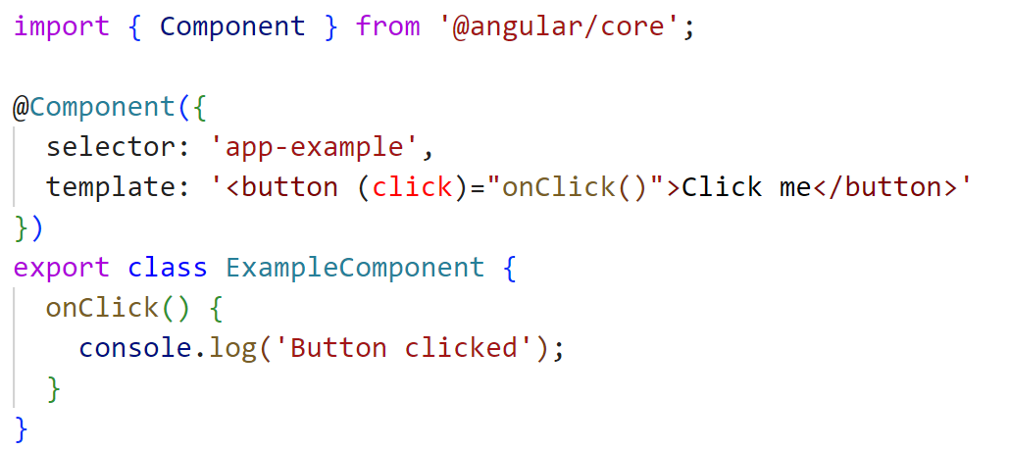
spyOn() Example

Slide 21
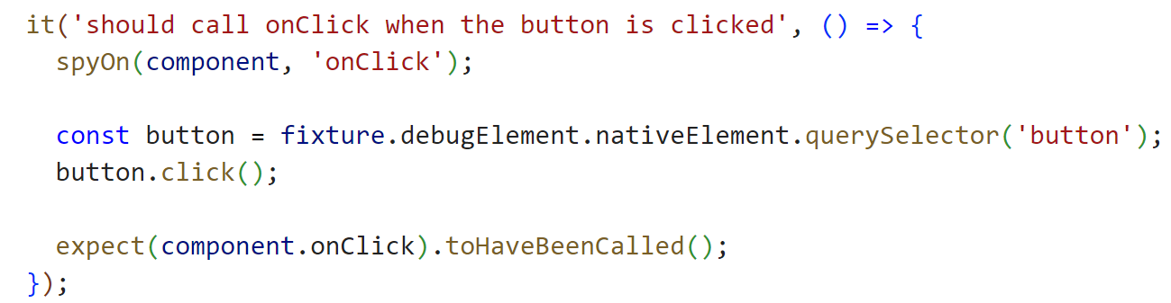
spyOn() Example

Slide 22
spyOn() - Example Explanation
The “spyOn()” function is used to spy on the “onClick()” method of the component
The button is clicked using nativeElement, simulating a user interaction
The test checks that the “onClick()” method was called using “expect()”

Slide 23
Http Service Testing
HttpClientTestingModule –
Provides a way to mock HTTP requests made by your services
This allows you to test HTTP interactions without making actual network requests, ensuring your tests are reliable and fast
It also helps verify that all expected HTTP requests are made
There are no unexpected or outstanding requests, ensuring thorough and complete test coverage
It replaces HttpClientModule in your tests

Slide 24
Http Service Testing
HttpTestingController –
Allows you to mock HTTP requests made by your application
You can verify that all expected HTTP requests have been made and that no unexpected requests remain
You can inspect and control the properties of outgoing HTTP requests
For Example - Method, URL, Headers, and Body
Provides the flush() method to simulate the server's response to the HTTP request

